Slide 1
Northern Murrieta Keyhole Stakeholder Meeting
March 26, 2024

Slide 2
Agenda
Northern Murrieta Keyhole Area Overview
Current development/Entitlements
Overview of Northern Keyhole Area Backbone Infrastructure Study
Road/Drainage Network
Water and Sewer
Annexation Requirements
Fees and Financial Considerations
Summary
Questions

Slide 3
Northern Murrieta Keyhole Area Overview

Slide 4
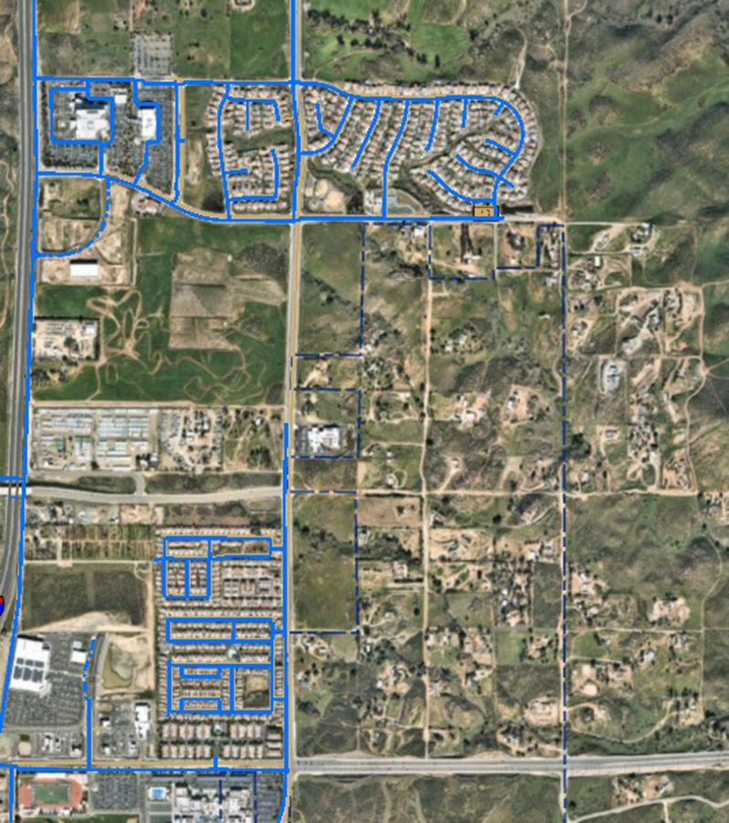
Current Condition
Rural Nature
Dirt Roads
No water/sewer infrastructure
Majority of area current outside EMWD’s service territory
Requires annexation
Multiple property ownerships
Resulting in ‘Patchwork’ development activity
= Murrieta Northern Keyhole area designation
Baxter Rd
I-215
Whitewood Rd
Menifee Rd
Clinton Keith Rd

Slide 5
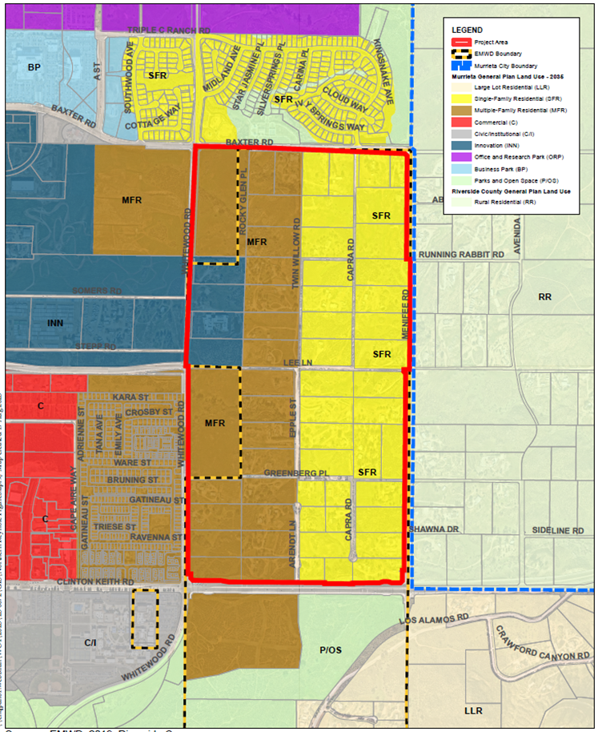
Updated Land Use
2,500 – 3,500 potential Dwelling Units (DU’s)
Basis:
Land use densities
Development applications
Notable land constraints

Slide 6
Service Issues
Required (Backbone) Infrastructure
Roadways and Drainage
Required to provide right-of-way and grade to construct water and sewer facilities
Water and Sewer
Demands/flows not accounted for in EMWD’s Master Plans
Water and sewer facilities not programmed in EMWD’s Capital Improvement Program (CIP)
Onsite/Interim vs. Offsite/Ultimate Facility Considerations
Cost impacts to area landowners/developers
Property annexation to EMWD
In addition to infrastructure costs
Inconsistent process timing amongst property ownerships
Backbone Infrastructure Funding/Financing Mechanism
Needed in addition to EMWD general district and treatment Financial Participation Charges (FPC’s)

Slide 7
Coordination Efforts
Community meeting- November 2022
Informational meeting in response to significant property owner and development interest inquiries
EMWD Task Force meetings- commenced December 2022
Backbone Infrastructure Planning Studies- commenced March 2023
Preliminary (Staff)
Required sewer facilities
Remaining available capacity in existing sewer system and Temecula Valley Regional Water Reclamation Facility (TVRWRF)
Preliminary (rough order of magnitude) sewer facility costs
Detailed (Consultant)
Roadways, drainage, water, sewer
Implementation costs

Slide 8
Current Development / Entitlements

Slide 9
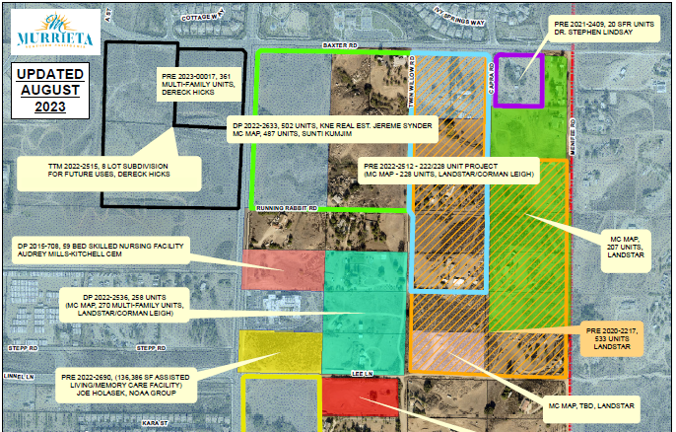
Proposed Developments- North Block
Notes:
To Do:
- Check with City for updates

Slide 10
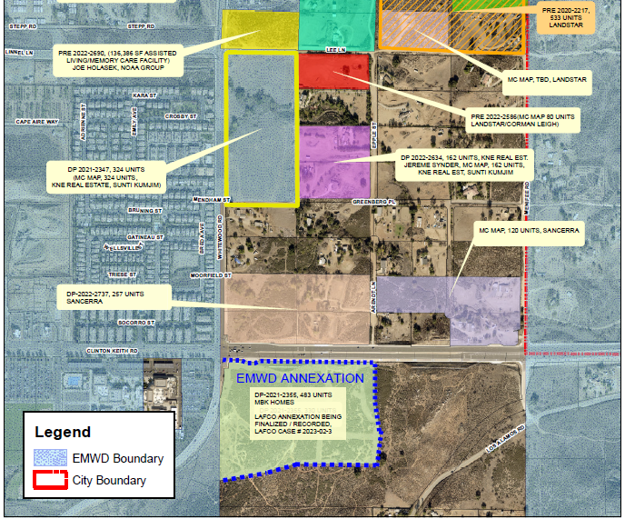
Proposed Developments- South Block
Notes:
To Do:
- Check with City for updates

Slide 11
Backbone Infrastructure Planning

Slide 12
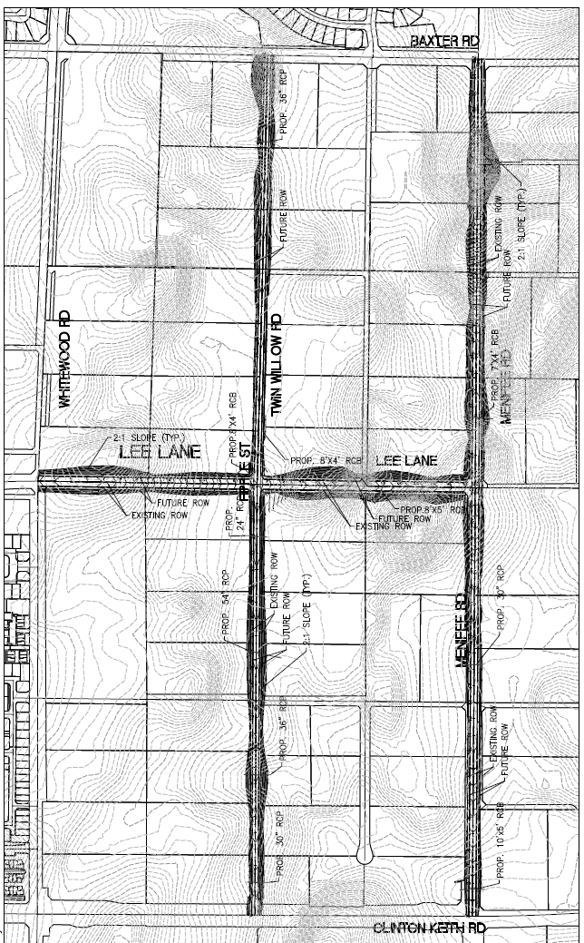
Roadways and Drainage
Backbone roadway grid
Interim road width per City Std. No. 113
Ultimate road profile established to accommodate drainage culverts, as well as backbone water and sewer pipelines
Requires slope easements and/or additional Right-of-Way (ROW) acquisition
Ultimate roadway would follow City Std 105
Collector Street with 44-foot wide pavement on a 66-foot wide right of way

Slide 13
Right of Way / Offers of Dedication
The City of Murrieta would need to take existing parcel maps to City Council for acceptance of offers of dedication of roadway easements to public use for street and public utility purposes to allow interim street improvement installations
The offers of dedication were made to the County of Riverside, as the underlying maps were typically recorded in the County of Riverside in the late 1970’s

Slide 14
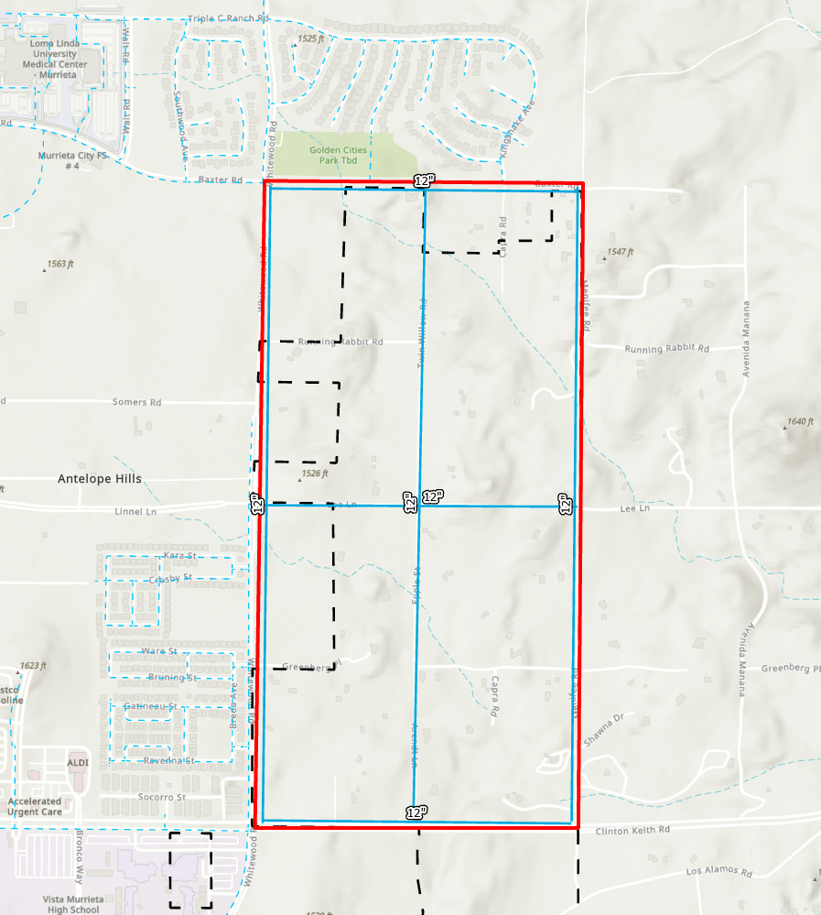
Proposed Water System
12-inch (on-site) Backbone water pipelines (1698 Pressure Zone)
Fire flow capability for multi-family development
Represents recommended deferral
Additional (off-site) water storage in 1698 PZ
2.31 MG (MDD)
Will be accommodated by 2nd Keller Tank (CIP Project)

Slide 15
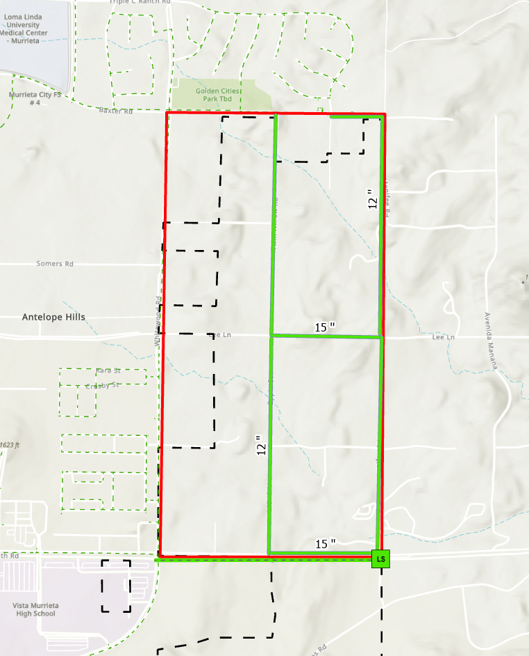
Proposed Sewer System - Interim
Gravity sewer backbone pipelines
Represents recommended deferral
Proposed sewer lift station and force main terminates at intersection of Whitewood Road and Clinton Keith Road
Utilization of remaining capacity in existing sewer system to TVRWRF
On-Site Phase 1 Gravity Sewer Mains
Phase 1 Sewer Lift Station and Force main

Slide 16
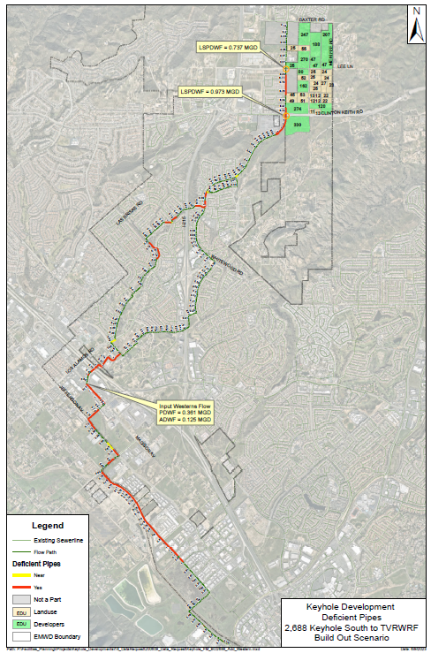
Remaining Available Capacity- Existing Sewer
Available capacity in the existing Temecula Valley sewer collection system ~ 2,000 EDU’s (10+ years)
Corresponding tributary area averaged 180 new EDU’s/year for the past 7 years
Not just available for Keyhole area
Tributary areas could consume remaining capacity (first come first serve)

Slide 17
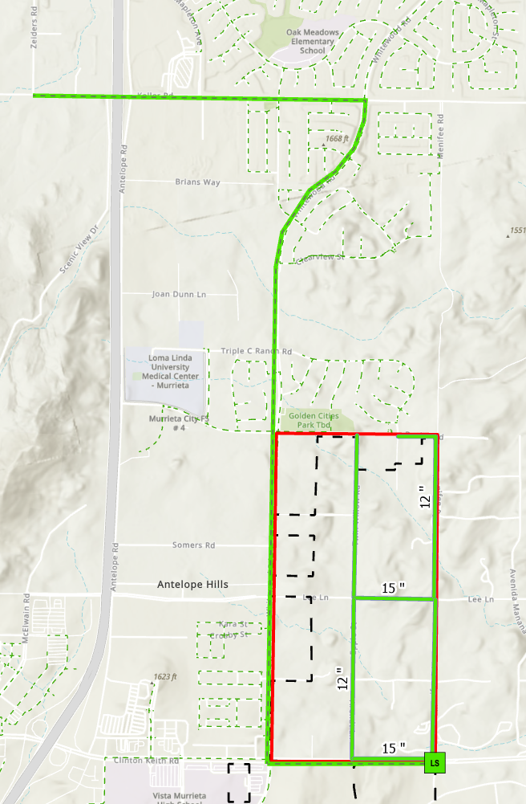
Proposed Sewer System - Ultimate
Extended sewer force main (approximately 3 miles) to convey flows to Perris Valley Regional Water Reclamation Facility (PVRWRF)
Abandonment of existing Baxter Road sewer lift station
Corresponding sewer flows conveyed to proposed regional lift station
Potential diversion of additional sewer tributary to PVRWRF
Upon reaching capacity limitations in existing sewer system to TVRWRF
Lower cost than upsizing deficient pipe segments
Off-Site
Phase 2 Sewer
Force main
On-Site Phase 1 Gravity Sewer Mains
I-215
Phase 1 Sewer Lift Station and Force main

Slide 18
Implementation
Infrastructure not currently programmed in EMWD’s or City’s Capital Improvement Program
Specific Plan development if proposed by City
Requires City Council approval of funding to advance
18 – 24 months to complete upon receipt of offers of dedication
Requires RCA / environmental conditions since this area was not included in the circulation element
Annexation into EMWD’s service area
18-month process
Funding strategy
Dependent on development activity
Incorporate backbone infrastructure into EMWD’s Capital Improvement Program
Upon annexation and development of funding strategy
Align design and construction schedule with need for ultimate sewering solution – likely within 10-year CIP
Developers would also be conditioned for localized/site specific water and sewer requirements

Slide 19
Annexation Requirements

Slide 20
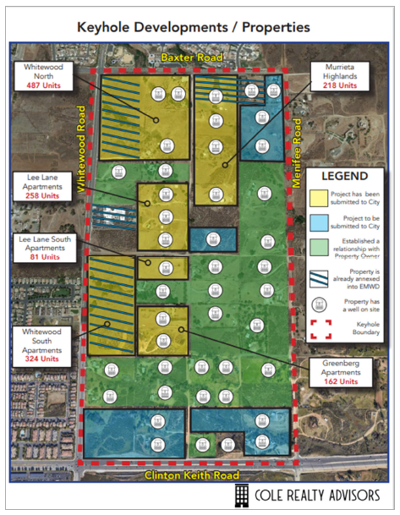
Annexation Process / CEQA Requirements
CEQA documentation
City of Murrieta General Plan
Amendment/Supplemental Documentation for Site Specific Plan
Project specific for fringe area annexation
Metropolitan and LAFCO process duration is approximately 18 months
Processing and acreage-based fees

Slide 21
Standard Fringe Area Annexation Process

Slide 22
Fees and Financial Considerations

Slide 23
Annexation Fees
 | Single application (multiple property owners and assume 10 – 200 acres) | Individual Lot Applications (assume less than 10 acres)
Metropolitan Water District | $5,000 per Application | $5,000 per Application
EMWD | $4,000 per Application | $4,000 per Application
LAFCO $6,450 (< 10 acres) $9,030 (10 to 200 acres) $11,610 (200+ acres) | $9,030 per Application | $6,450 per Application
Riverside County Surveyor | $1,000 per Application | $1,000 per Application
*Metropolitan Water District (due at the end of the process) | $7,596 per acre | $7,596 per acre
TOTALS | $95,000 - $1,538,000 (10 – 200 acres) | $24,000 - $92,000 (1 - <10 acres)
*Calendar Year 2024 - $7,596 (increases annually and the interested party would likely pay 2025 fees since the process takes 18 months (minimum) to complete.
$2.1M estimated annexation cost for the entire 272 acres currently not annexed (if single application)

Slide 24
Connection Fees
Based on current infrastructure and anticipated costs of facilities identified in EMWD’s Master Plan
The current Capital Plan is based on the 2015 Master Plans for sewer and water
Most of the Northern Keyhole area was not included in the Master Plan and therefore infrastructure needed in this area was not contemplated in the current connection fees or Capital Plan
Example of connection fee calculation:
Additional fees in addition to standard connection fees likely for this area since the connection fees do not currently include infrastructure in this area
Component | Fee
Water Financial Participation Charge (1 EMS) | $7,416
Water Supply Development Fee (1 EDU) | $403
Sewer Financial Participation Charge (1 EDU) | $3,476
Sewer Treatment Plant Capacity Charge (1 EDU) | $6,589
Example Connection Fee Total for 1 EDU/EMS | $17,880
1-inch Master Meter/Service Install | $5,340

Slide 25
Backbone Infrastructure Conceptual Level (Study) Cost Estimate
Component | Planning Level Estimated Project Costs | Onsite¹ | Offsite²
Roadway³ | $11,200,000 | $11,200,000 | N/A
Water | $9,690,000 | $7,700,000 | $1,990,000
Sewer | $29,600,000 | $19,000,000 | $10,600,000
TOTALS | $50,490,000 | $37,900,000 | $12,500,000
Onsite are backbone/minimum facilities required within the Keyhole area to provide water and sewer service on a first come first serve basis.
Offsite include the permanent infrastructure required to provide water and sewer service to this area at build out. Timing will be dependent on development and reaching capacity in the existing sewer system to TVRWRF.
Cost based on interim access road with 32-foot wide pavement on the existing 60-foot wide right of way. Ultimate will require 44-foot wide pavement on a 66-foot wide right of way.

Slide 26
Infrastructure Financial Considerations
Infrastructure funding strategy that is equitable to beneficiaries
Developer led and funded infrastructure
EMWD potential participation in facility oversizing
Potential financing mechanisms may include CFD, assessment/improvement district, reimbursement agreements, etc.
A Community Facilities District (CFD) would require 2/3 approval from voters if greater than 12 properties
If a CFD was contemplated, City would lead
City could allow water and sewer improvements to be included in City CFD
EMWD would participate through a Joint Community Facilities Agreement (JCFA) since ownership and operations would be provided by EMWD

Slide 27
Summary
Developers / Property Owners are responsible for fees
Annexation fees range from $26,600 for 1 acre to >$1,500,000 for greater than 200 acres
Connection fees are currently $18,000 per EDU plus $5,000 meter install fee
Backbone infrastructure in Northern Keyhole Area estimated at $50,490,000
$139,300- $185,600 per acre
Dependent on how costs are allocated for benefiting area
Infrastructure not currently programmed in EMWD’s or City’s Capital Improvement Programs
City would need City Council approval to advance specific plan and associated costs if proposed
18 - 24 months to complete
Annexation into EMWD’s service area is required
18-month process
Feedback from property owners on interest in annexation / development in order to confirm next steps

Slide 28
Questions

Slide 29
Joe Mouawad General Manager (951) 928-6130 mouawadj@emwd.org Nick Kanetis Deputy General Manager (951) 928-6161 kanetisn@emwd.org John Adams CFO/Assistant General Manager (951) 928-3777, ext. 4363 adamsj@emwd.org Lanaya Voelz Alexander Assistant General Manager (951) 928-3777, ext. 4561 alexandl@emwd.org Armando Arroyo Director of Development Services (951) 928-3777, ext. 4480 arroyoa@emwd.org Laura Barraza Director of Water Resources and Facilities Planning (951) 928-3777, ext. 4228 barrazal@emwd.org Chris Teague Real Property Manager (951) 928-3777, ext. 4243 teaguech@emwd.org Roxanne Rountree Public Affairs Manager (951) 928-3777, ext. 4391 rountrer@emwd.org
Ivan Holler Assistant City Manager (951) 461-6010
IHoller@MurrietaCA.gov David Chantarangsu Development Services Director (951) 461-6002 ChantarangsuD@MurrietaCA.gov Bob Moehling Director of Public Works/City Engineer (951) 461-6036 BMoehling@MurrietaCA.gov

